Slide 1


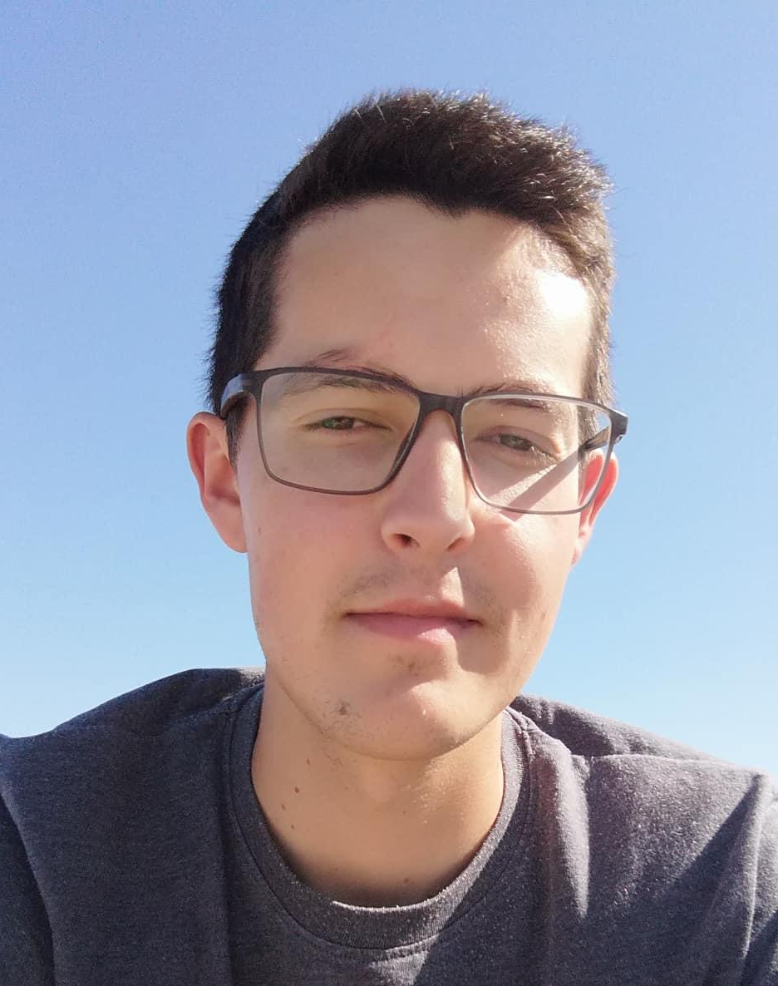
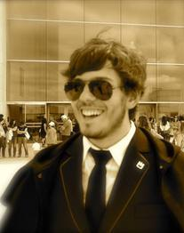


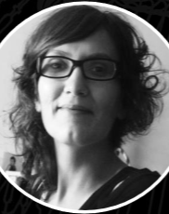


GROUP 01
Mobile App
Communication with the sensor
Connect/Disconnect via bluetooth MVP
Read values from sensor MVP
Read QR Code/ Barcode to immediate identification of the sensor MVP
Communication with the API
Login MVP
Create notes MVP
Delete notes MVP
Edit notes MVP
List notes MVP
List process MVP
Finish process MVP
Data Analysis
Prediction MVP
Confidence band MVP
Normalization of curves MVP
BLE (Bluetooth Low Energy)
BLE Server development MVP
Real time communication protocol deployment MVP
Encrypted communication EXTRA
Improved connection security EXTRA
OTA firmware updates EXTRA
Search available devices EXTRA
Team
Rodrigo Rocha 71731
Rodrigo Oliveira 71860
Fábio Nunes 80109
João Jesus 80098
Diana Silva 80239
Susana Dias 80410
Mentors
Rogério Nogueira
Lúcia Bilro
Pedro Costa
Visit our website for more information:
http://xcoa.av.it.pt/~pei2018-2019_g01/

